Slide 1
Módulo 1 Automation and Cost Management Project Based on TAGs in AWS
Institution: Instituto de Tecnologia e Liderança – INTELI
Business Partner: Thomson Reuters
Authors:
Gustavo Monteiro
Advisor: Rodolfo Riyoei Goya

Slide 2
Agenda
Introduction
Problem Definition and Objectives
Personas
Lean Inception
AWS Technologies and Services
Solution Architecture
Initial Implementation and Challenges
Conclusion and Next Steps

Slide 3
Introduction
Objective: Develop a methodology for cost-tagging in AWS.
Goal: Optimize cost control and increase operational efficiency.
Methodology: Use APIs for data collection and create an implementation guide.
Thomson Reuters Overview: Provides information and technology solutions.
Focus Areas: DevOps for collaboration and FinOps for financial management

Slide 4
Problem Definition and Objectives
Core Challenges:
Development Environment Setup
Tag Definition for Infrastructure
Report Development and Data Visualization
Objectives:
Setup development and testing environment
Define tagging standards
Develop data collection API
Create dashboards for visualization
Train stakeholders

Slide 5
Personas
DevOps Engineer:
Focus on infrastructure setup and maintenance
Objectives:
Efficient AWS service implementation and management.
Optimize deployment, scaling, and system availability.
Collaborate to align infrastructure with application needs.
Software Developer:
Develop and maintain AWS-based systems
Objectives:
Develop and maintain portals, web services, and messaging systems on AWS.
Ensure integration and functionality of system components with AWS.
Collaborate with DevOps to optimize deployment and performance.
FinOps Specialist:
Monitor and analyze AWS service costs
Objectives:
Monitor and analyze AWS costs for effective budget management.
Implement tagging for accurate cost tracking and allocation.
Identify cost-saving opportunities and resource optimization strategies.

Slide 6
Lean Inception
Is: A cost tagging system on AWS designed to implement an effective cost-tagging methodology applicable to all billed services.
Is Not: Not a comprehensive BI solution or an independent security system.
Does: Allows tag configuration and API integration for cost management.
Does Not Do: Does not support machine learning algorithm development or automated data quality verification.

Slide 7
AWS Technologies and Services
Research and Selection Criteria:
Prioritize AWS services already used by the company to ensure integration into the current ecosystem.
Use common AWS cloud services to generate costs to be monitored. Since the logic can be applied to other types of services, it makes the product of this project scalable.
Focus on services that align with scalability, security, and data confidentiality requirements.
Selected Tools and Services:
Compute: EC2 instances for virtual machines, Elastic Load Balancer for traffic distribution.
Storage: EBS volumes for persistent storage, S3 for scalable object storage.
Database: RDS for relational databases, Redshift for data warehousing.
Data Processing: Glue for ETL tasks, integrating data from various sources.
Support Services: IAM for access control, CloudFormation for infrastructure automation.

Slide 8
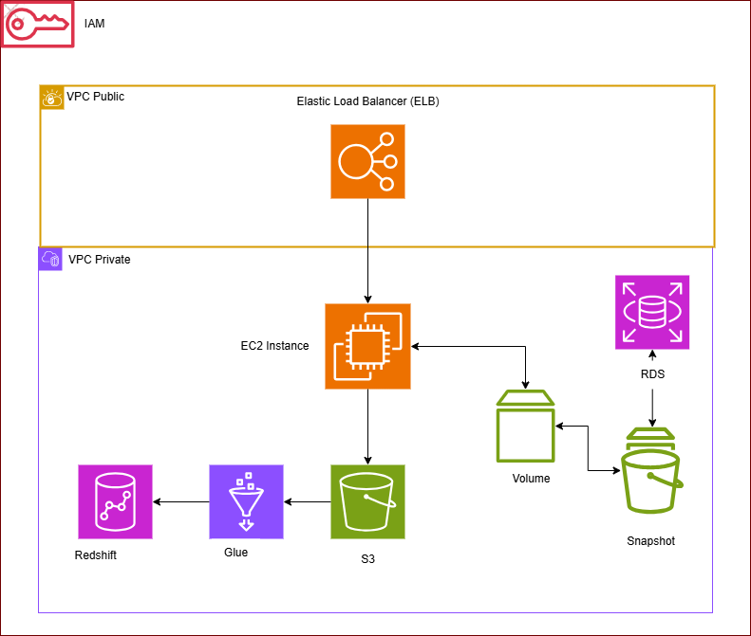
Solution Architecture
Architecture Overview:
Network Layer: VPC
Compute Layer: EC2, ELB
Storage Layer: EBS, S3
Database Layer: RDS, Redshift
Data Processing: Glue

Slide 9
Initial Implementation and Challenges
Development Environment Setup:
Establish a dedicated AWS Lab environment for experimentation and learning.
Use AWS CloudFormation to automate resource creation and configuration.
Challenges:
$50 budget cap necessitates careful cost management.
Tight control; participants can't create security groups.
Restricted use of AWS Lambda functions and Amazon EventBridge rules.

Slide 10
Conclusion and Next Steps
Achievements:
Established a foundation for AWS cost management through effective tagging practices.
Utilizes stacks for managing AWS resources as single units, simplifying resource management.
CloudFormation template automates deployment of resources like EC2, S3, and Redshift.
Next Steps:
Refine tagging practices to enhance cost control and operational efficiency.
Implement practical guide for stakeholders to ensure successful adoption of new practices.
Explore automation strategies for service management to optimize resource usage.

Slide 11
Thank you

